Slide 1
Towards Implicit Content-Introducing for Generative Short-Text Conversation Systems
EMNLP-2017
Lili Yao, Yaoyuan Zhang, Yansong Feng Dongyan Zhao and Rui Yan
Peking University, Beijing Institute of Big Data Research
Notes:
使用一个多重位置的句子表达的深度模型去做语义匹配

Slide 2
Background
Conversation systems(single-turn)
  A: What are you doing?
  B: I’m talking to you.
Dialogue systems(multi-turns)
A: What’s your name?
B: Mike.
A: How old are you?
B: 12. What’s your name?
A: jack
...
Notes:
对于一个文本对进行语义上的匹配评估

Slide 3
Background
Open domains
Content: diversity and uncertainty
for example: chatbot
Closed domains
Content: limited to a specific domain
For example: customer service robot

Slide 4
Background
Two main methods
A: Retrieval-based
search preestablished database for candidate responses by query retrieval
B: Generation-based
generate a new, tailored utterance given the userissued query

Slide 5
Background
Factors affecting the quality of responses
1. Responses should be fluent
2. Semantic or topic relevant
3. Appropriate emotion
…

Slide 6
For this paper:
1. Conversation system(single-turn)
2. Open domain
3. Generation-based methods (seq2seq)
4. Focus on Semantic or topic relevant

Slide 7
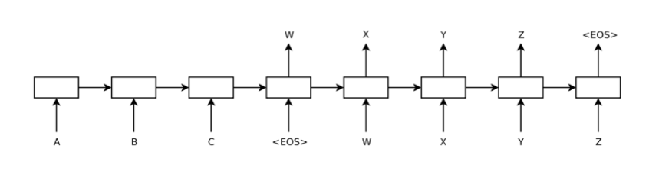
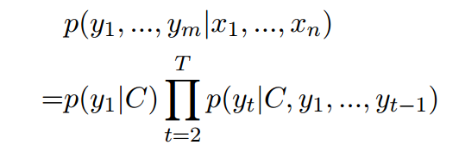
Related work
Standard seq2seq
Notes:
首先看第一个联盟，也就是各自联盟，1用户有动机去加入2联盟，这样就可以把花费从33降到30，因此联盟一不稳定。再看第二个联盟，用户2有动机加入1联盟，也可以把花费从33降到30。第三个联盟没有用户有动机跳到另一个联盟，因此是这个博弈的纳什均衡。第四个联盟中用户3有动机从联盟脱离，这样可以把花费从81降到80，因此即使这样联盟总花费最少，也不是纳什均衡。

Slide 8
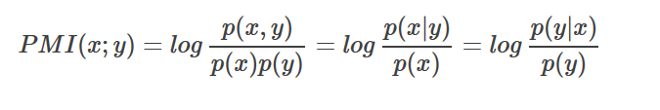
Related work
A Content-Introducing Approach
1. Predict a keyword(noun) for the reply by PMI
2. Generate a reply conditioned on the keyword as well as the query
Notes:
首先看第一个联盟，也就是各自联盟，1用户有动机去加入2联盟，这样就可以把花费从33降到30，因此联盟一不稳定。再看第二个联盟，用户2有动机加入1联盟，也可以把花费从33降到30。第三个联盟没有用户有动机跳到另一个联盟，因此是这个博弈的纳什均衡。第四个联盟中用户3有动机从联盟脱离，这样可以把花费从81降到80，因此即使这样联盟总花费最少，也不是纳什均衡。

Slide 9
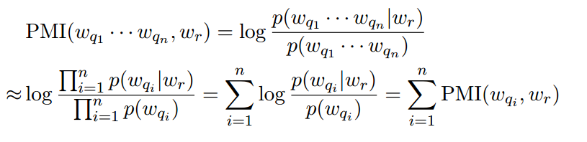
Related work
Given a query(Wq1, · · · Wqn.) and a large corpus,
the keyword noted as Wr.
Notes:
A1-A2: 哪个关键词起到的作用更大，得到的结果可能不同
A2-A3：同一个关键词在不同的语境中也有不同意思

Slide 10
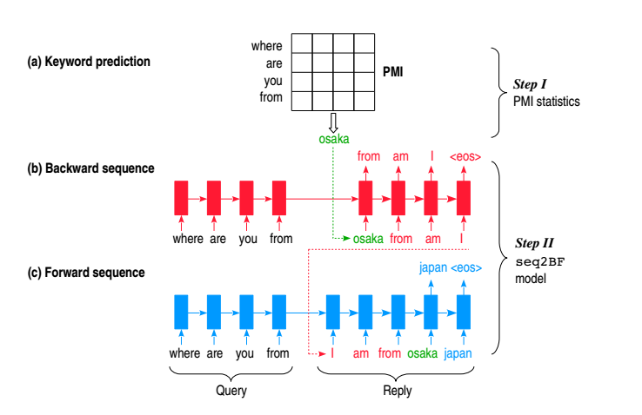
Related work
(Mou, et al.) Sequence to Backward and Forward Sequences: A Content-Introducing Approach to Generative Short-Text Conversation. COLING 2016.
Notes:
A1-A2: 哪个关键词起到的作用更大，得到的结果可能不同
A2-A3：同一个关键词在不同的语境中也有不同意思

Slide 11
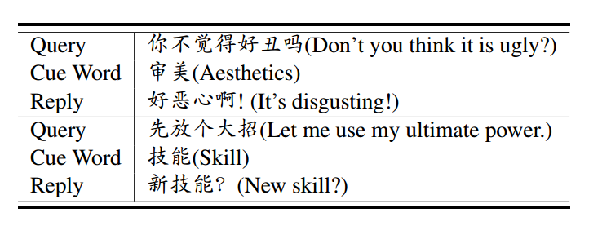
Motivation
1. Explicit Content-Introducing method is to some extent rigid.
2. Sometimes, it is better to generate a semantic related sentence based on the cue word rather than including it in the reply directly.

Slide 12
Motivation
Challenges of Content-Introducing method:
How to add the additional cue words during the generation process ?
How to display the cue words in replies ?
For example: explicit or implicit ?

Slide 13
The contributions of this paper:
1. This paper proposes the cue word GRU, another neural cell, to deal with the auxiliary information. Compared with other gating methods, our cue word GRU is more flexible.
2. We focus on the implicit content-introducing method during generation: the information of the cue word will be fused into the generation process but not necessarily occur explicitly.

Slide 14
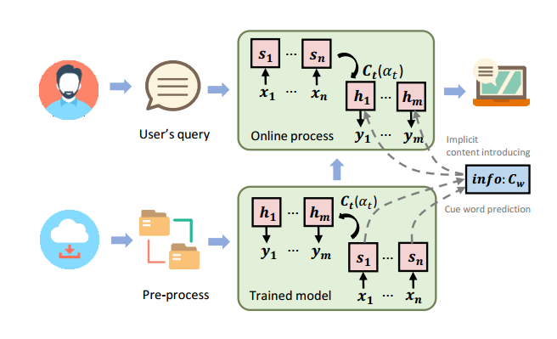
Model
The architecture of this system

Slide 15
Model
Information Fusion Patterns
1. we fuse the cue word Cw as the auxiliary information only in the beginning of decoding. (Local information initialization )
2. which fuses the cue word Cw as the auxiliary information at every step of decoding. (Global information inception)

Slide 16
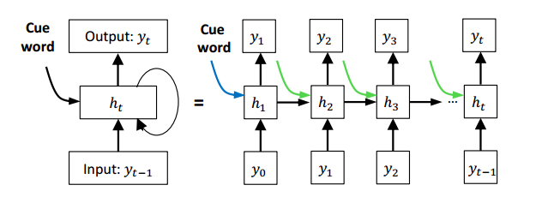
Model
Information Fusion Patterns

Slide 17
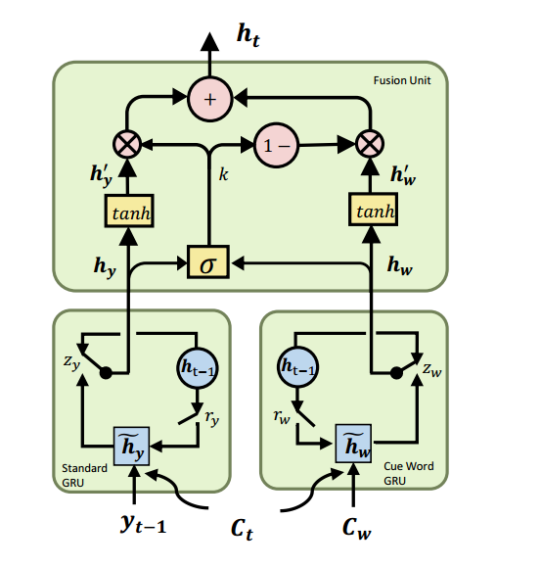
Hierarchical Gated Fusion Unit(HGFU)
Model

Slide 18
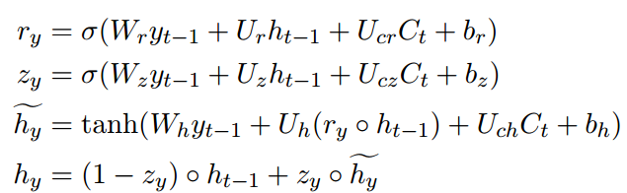
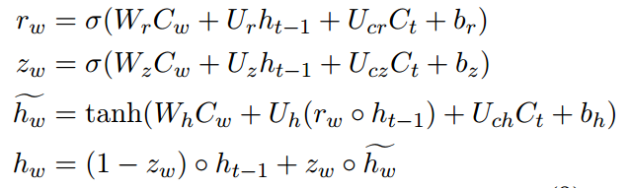
Model
Standard GRU
Cue word GRU

Slide 19
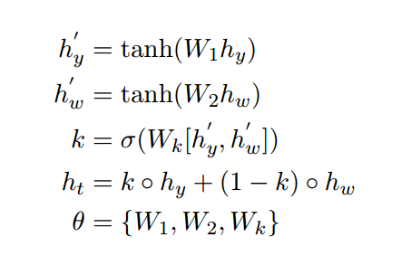
Model
Fusion unit
θ is the parameters to be learned.
K is the gate neuron to controls the the contribution of the information calculated from hy and hw.

Slide 20
Experimental setup
Dataset: crawled from the Baidu Tieba, including 500,000 (query – reply) pairs for training, 2,000 for validation, and another unseen 27,871 samples for testing.
Vocabulary size: 63,000 words
word embedding dimensionality: 610
Batch size: 80
objective function: the cross entropy cost function
Early stopping was implemented to prevent overfitting.

Slide 21
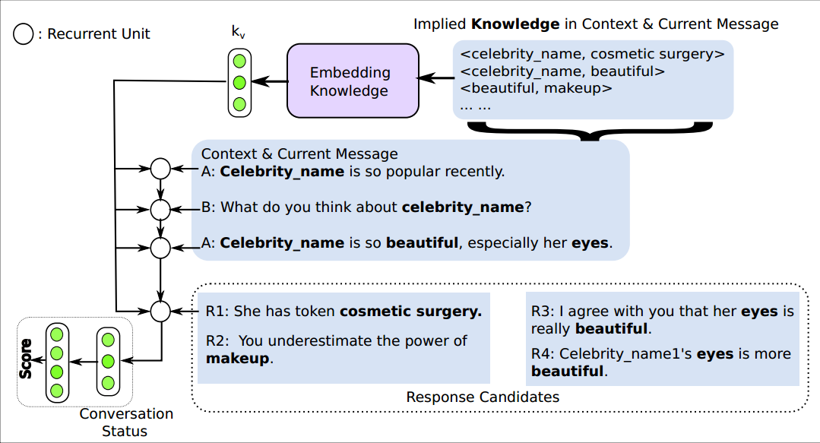
baselines
rGRU

Slide 22
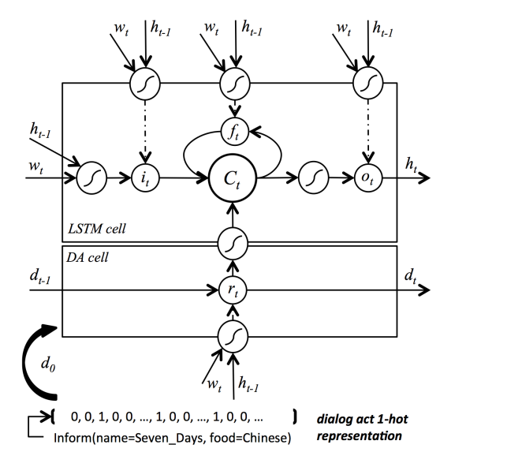
baselines
SCGRU

Slide 23
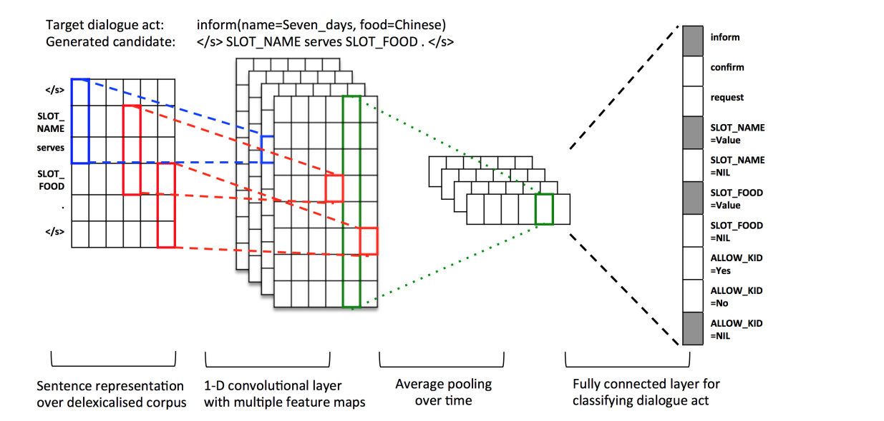
SLGD

Slide 24
Experiment Evaluation
Objective metrics: BLEU
Subjective metrics: 5 annotators to offer a judgment. Each reply will score from 0 to 2:
0 : Unsuitable reply
1: Neutral reply.
2. Suitable reply

Slide 25
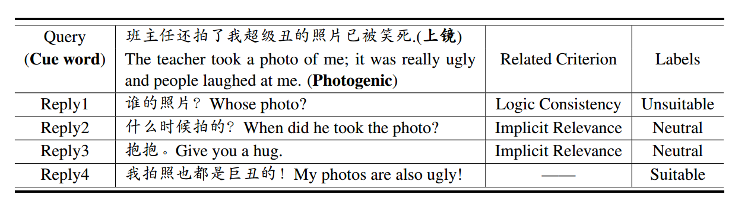
Experiment Evaluation
An example of Subjective metrics

Slide 26
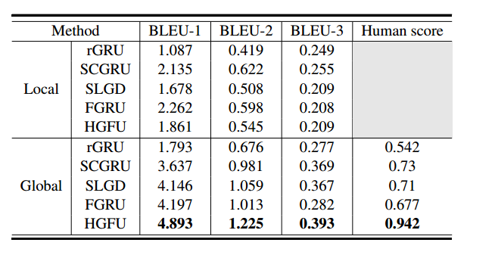
Experiment Performance
Performance of evaluated methods.

Slide 27
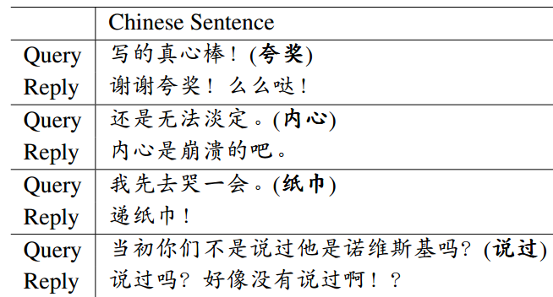
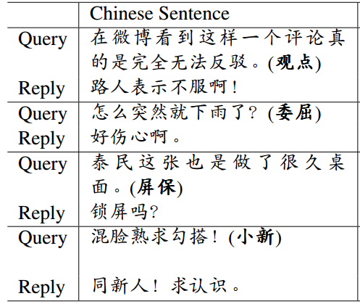
Case Studies
explicit introducing-content
implicit introducing-content

Slide 28
Conclusion and Future Work
1 . We explore an implicit content-introducing method for generative short-text conversation system by HGFU.
2 . In the future, we may extended the HGFU to multi-turns dialogue systems.

Slide 29
Thank you !

